Slide 1





HUMAN RESOURCE MANAGEMENT SYSTEM

Slide 2
TEAM MEMBERS :
P.RAJESWARI
B.S.KARTHAYANI
S.TEJA
K.DINESH REDDY
S.ABDUL MALIK
: 214M5A0408
: 214M5A0401
: 214M5A0409
: 204M1A0456
: 204M1A05A4

Slide 3
CONTENTS :
1.Introduction
2.Purpose Of The Project
3.Objective Of The Project
4.Scope Of HRMS
5.Workflow Of HRMS
6.Employee Description
7.Employee Onboarding
8.Leave management
9.Performance Management
10.Payroll management
11.Recruitment and Application tracking,
Training and development
12.Implementation Tools And Languages Used
13.Dashboard Applications
14.Conclusion

Slide 4
INTRODUCTION
To develop a Software application that supports the application specific to the HR automation in an intranet specific to a company there by allowing the integration of all the employees pertaining to that organization.
To allow the HR of an organization to update the employee details whenever there is a change in the employee profile pertaining to that organization.
To bring onto a string the employee specific suggestions and make them free to post their requirements to the HR thus bringing the organization more specific regarding the maintenance of the organization.

Slide 5
PURPOSE OF THE PROJECT :
The HR center is a powerful application designed to allow companies to streamline their human resource tasks and manager their employees more efficiently.
Employee Onboarding
Leave Management
Performance management
Payroll Management
Recruitment and Applicant Tracking
Training and Development

Slide 6
OBJECTIVE OF THE PROJECT :
To allow the HR department of an organization to update the employee details when ever there is a change in the employee profile pertaining to that organization.
To bring on to a string the employee specification suggestions and make them sure to post their requirements to the HR.
To keep track of all the other departments related to that organization like marketing, research etc.,

Slide 7
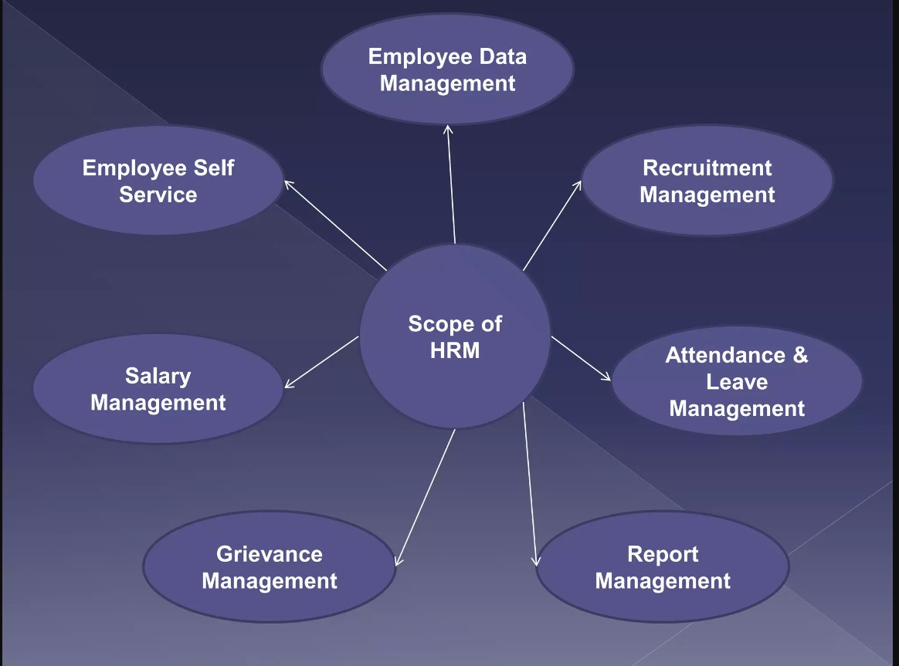
SCOPE OF HRMS

Slide 8
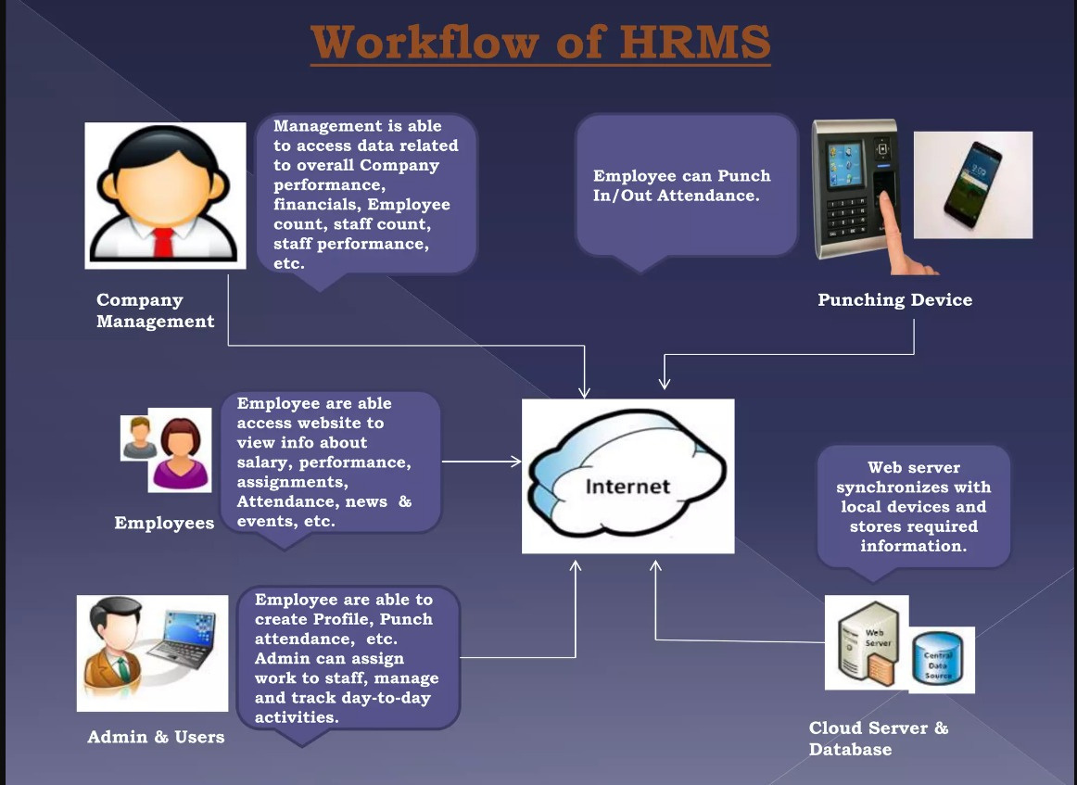
WORKFLOW OF HRMS

Slide 9
EMPLOYEE DESCRIPTION :
The list of incorporated with “Human ResourceManagement System”
Employee Onboarding
Leave Management
Performance management
Payroll Management
Recruitment and Applicant Tracking
Training and Development

Slide 10
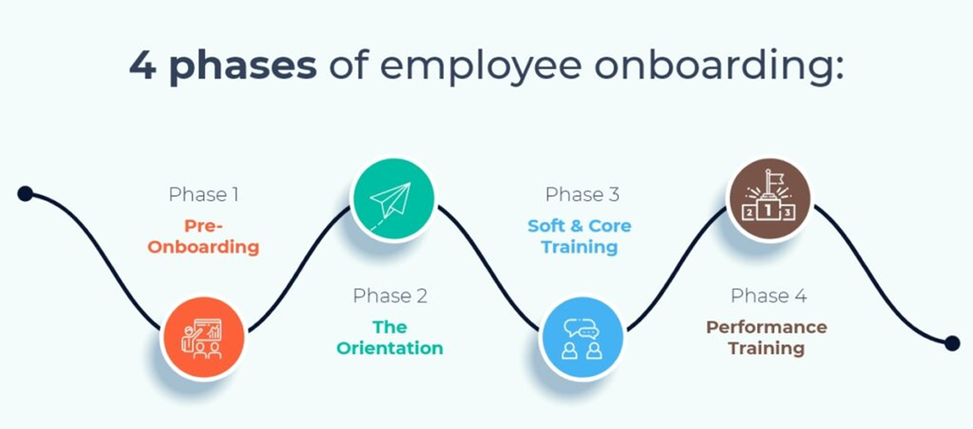
EMPLOYEE ONBOARDING :

Slide 11
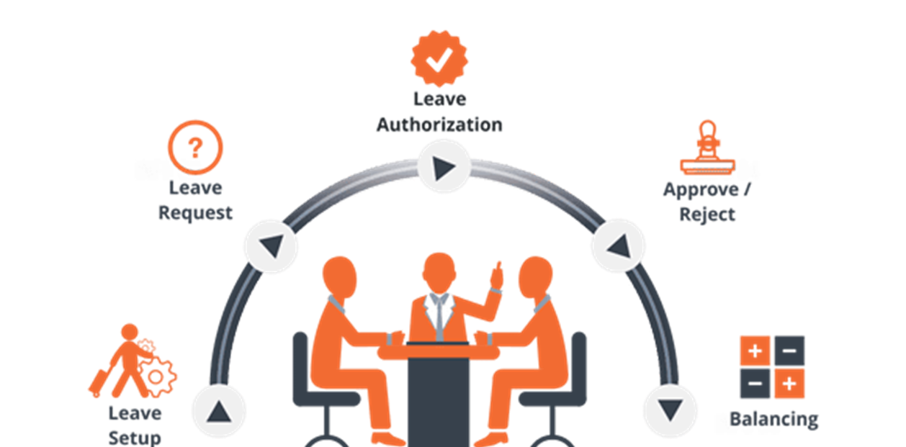
LEAVE MANAGEMENT :

Slide 12
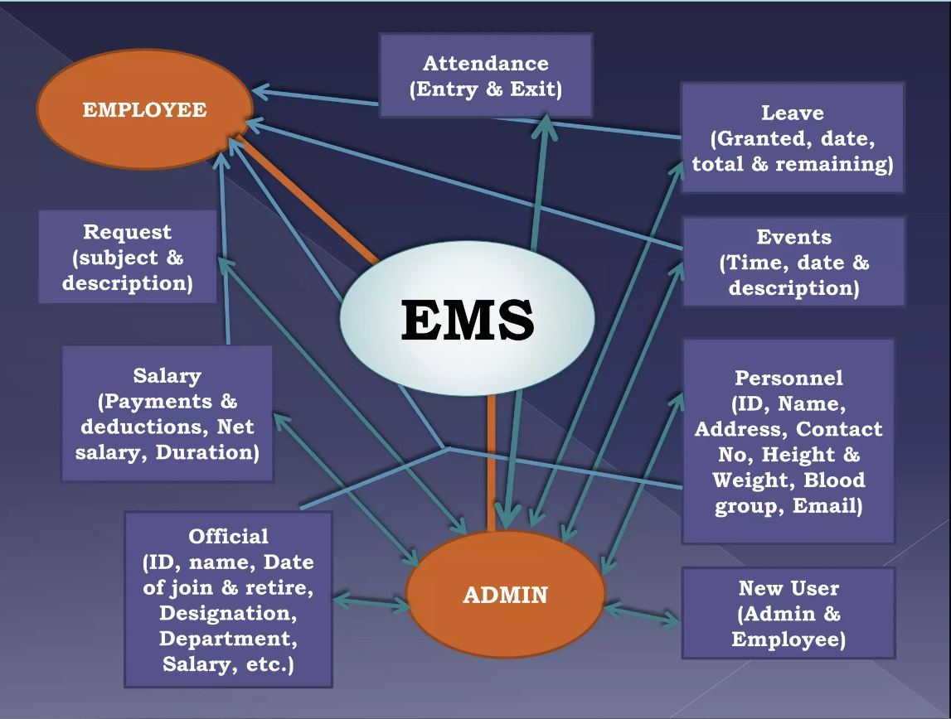

Slide 13
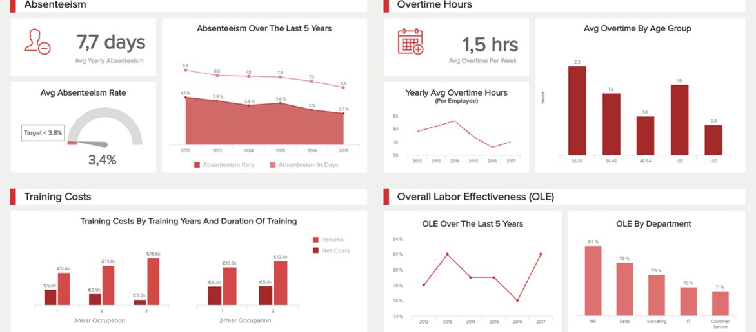
PERFORMANCE MANAGEMENT :

Slide 14
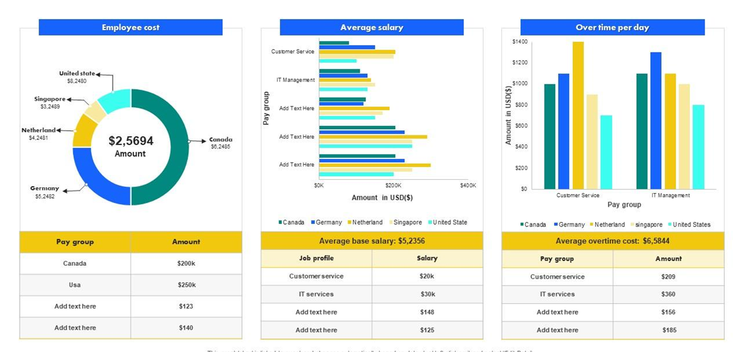
PAYROLL MANAGEMENT

Slide 15
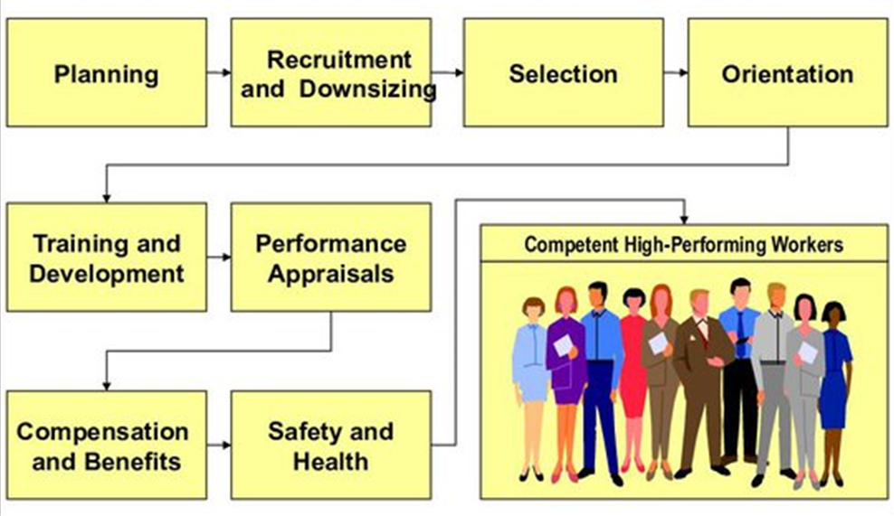
RECRUITMENT,APPLICANT TRACKING,
Training and Development

Slide 16
IMPLEMENTATION TOOLS AND LANGUAGES USED
TOOLS :
VISUAL STUDIO CODE SOFTWARE- FRONTEND & BACKEND
LANGUAGES :
HTML (Hyper Text Markup Language)
CSS (Cascading Style Sheets)
JS (Java Script)
Structured Query Language(SQL)

Slide 17
REFERENCES
01 - GAIN INFORMATION FROM TRAINERS & HR'S.
02 - DAILY LIVE SESSIONS.
03 - RESEARCH FROM CASE STUDIES.
04 - ONLINE REFERENCES.

Slide 18
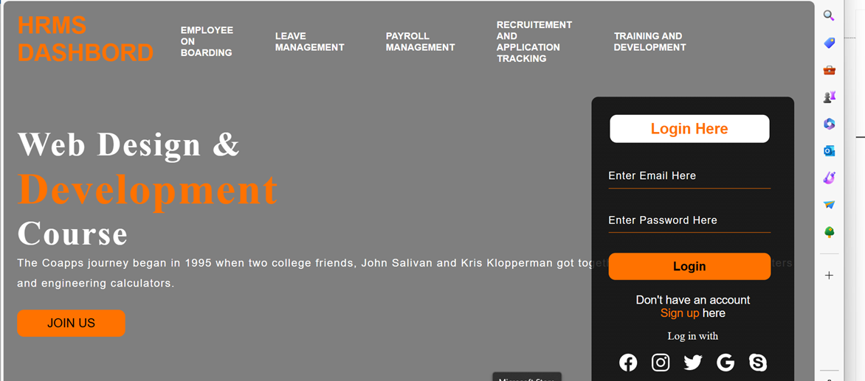
DASHBOARD :

Slide 19
CONCLUSION
In conclusion, the development of our HRMS webpage represents a significant step forward in optimizing our human resource management processes.
Through meticulous planning, collaboration, and attention to detail, we have designed a platform that streamlines key HR functions, enhances employee experiences, and ultimately contributes to organizational success.
Our HRMS webpage serves as a central hub for all HR-related activities, offering intuitive navigation, comprehensive features, and seamless integration with existing systems.

Slide 20
THANK YOU

